Slide 1

Release note BMS-ENGI-FOR-006 June 2026

Slide 2
Why a release note
Nomad’s need
What do we have on board?
Before: to know what to deploy
After: in case of issue to analyse, to know:
Is there a known issue on versions deployed
Can we compare with other projects
What are differences since last working version
So we need to save all data that can impact behaviour
Customer need
Know what’s on board
Ensure same behaviour on all fleet

Slide 3
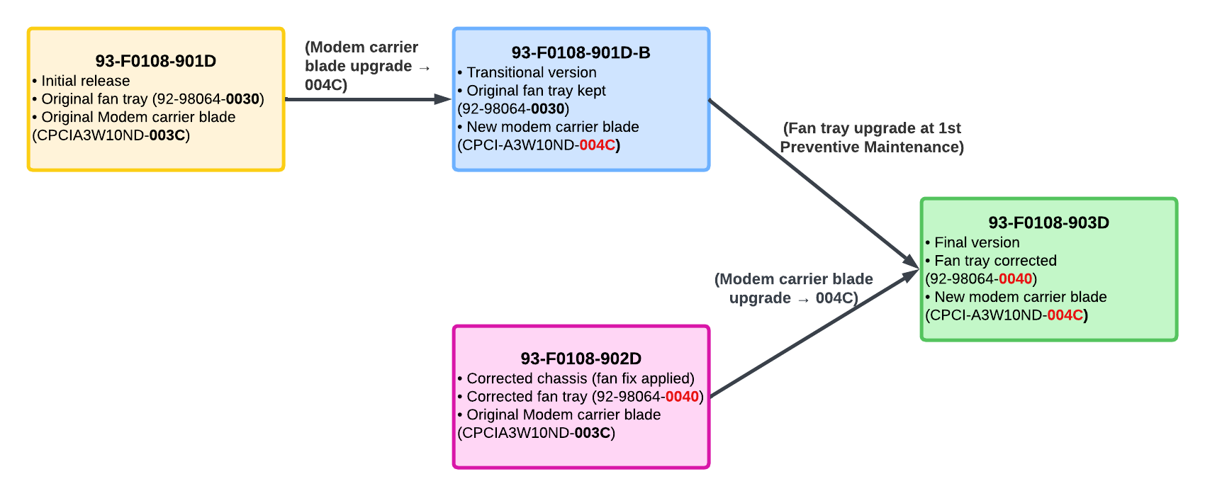
Content HW
Reference: specification, for technical content definition
Hardware:
For each material
Title
Reference (NMID, + customer reference if any)
Hardware version
Firmware version
Configuration version
For some (long) projects, we can have evolution
If several HW version, enable way to know which version for which material, for example with serial number list, or application rank for new version
If version follow up is not as simple as incrementation, don’t hesitate to explain (ex : )
We should be able to check data
HW version on label of material
FW & configuration on software (NMS, material GUI, engineering pages, …)
Few passive equipment don’t have versions. Mention them, with NA.

Slide 4
Content SW
Software version
Nomad connect
Configuration
Portal (framework + content) if delivered by Nomad
Software testing tool
NMS
WifiTestTool
Iperf
Ekahau
… depending on what is defined for the project
Version may impact tests results, so important to know what was used!

Slide 5
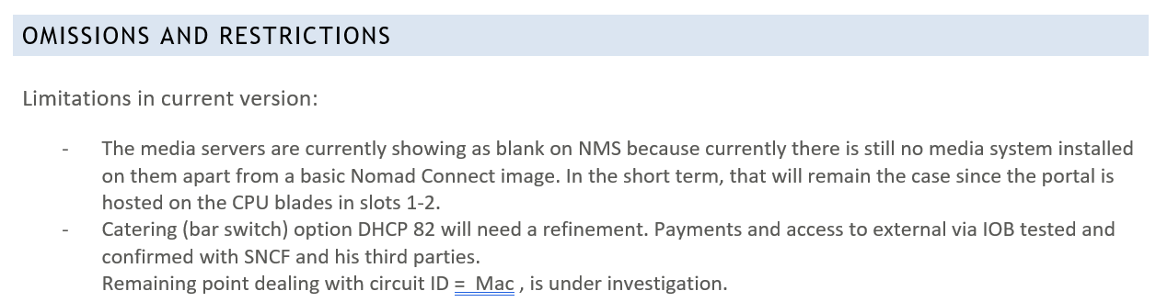
Modifications
If release note is an update from a previous one
Indicate new functions added (ticket, headline)
Mention corrections, same format
Precise restrictions if any. Example below

